Slide 1
Belize 2016
Literacy Alive III

Slide 2
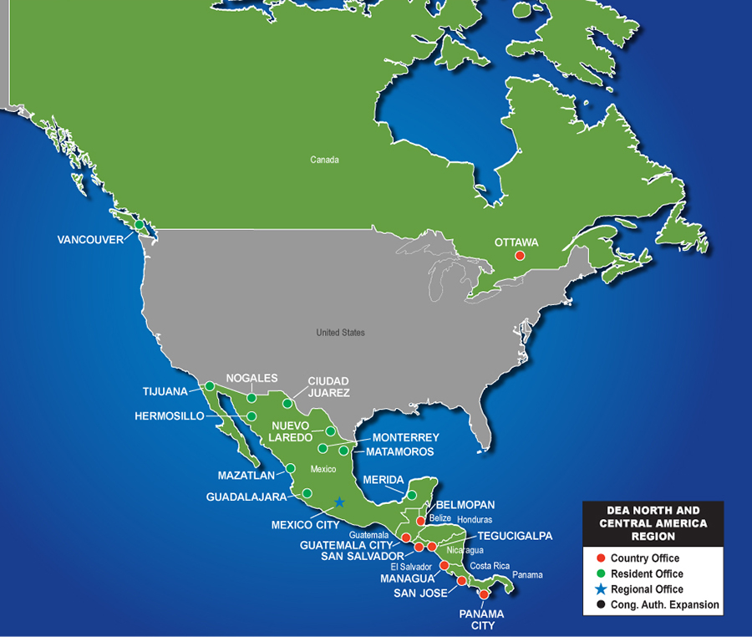
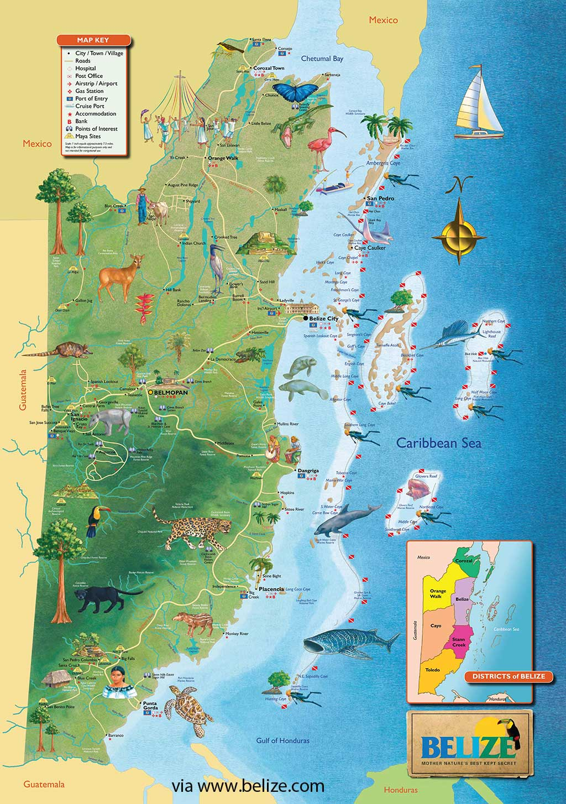
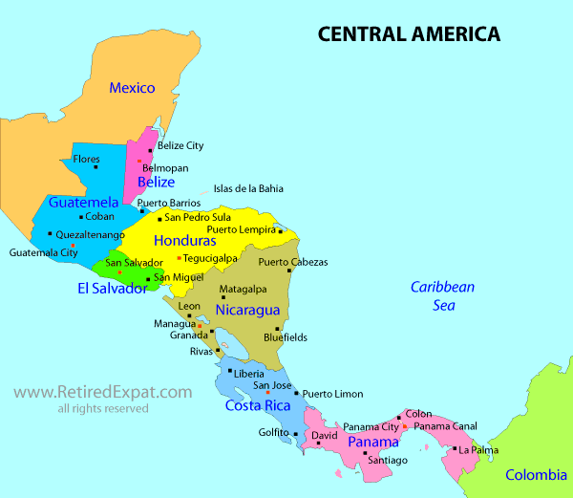
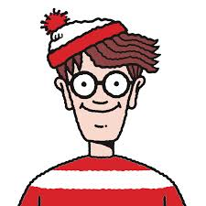
Where in the world is this place?

Slide 3
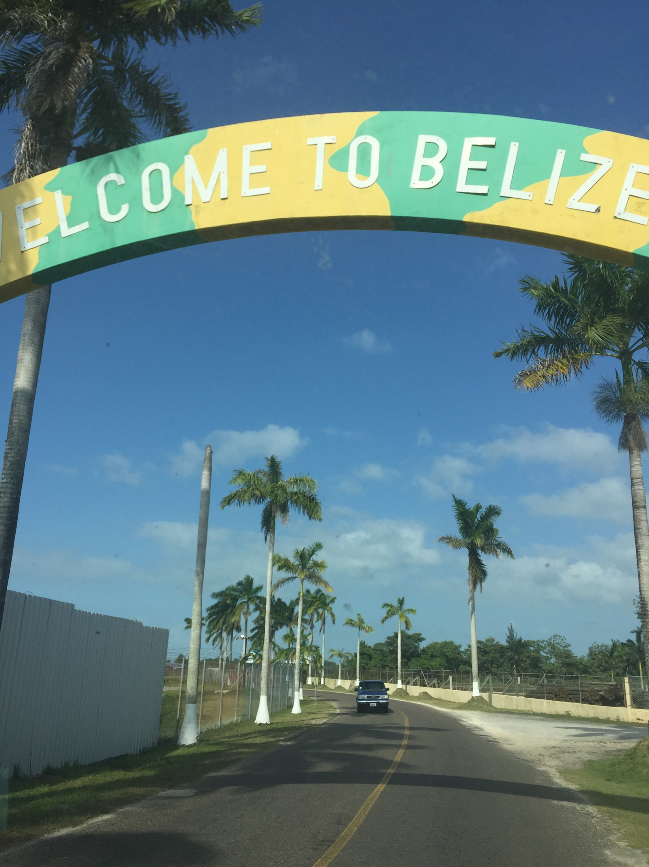
Why Did We Go?
Went as part of a Rotary sponsored
initiative to promote literacy
worldwide
Belize was chosen for a few reasons; the most important being that they speak English
Very low literacy rates and even lower high school completion rates (only about 15% graduate according to SIB)*
Notes:
*15% of West Park Elementary is about 48 students

Slide 4
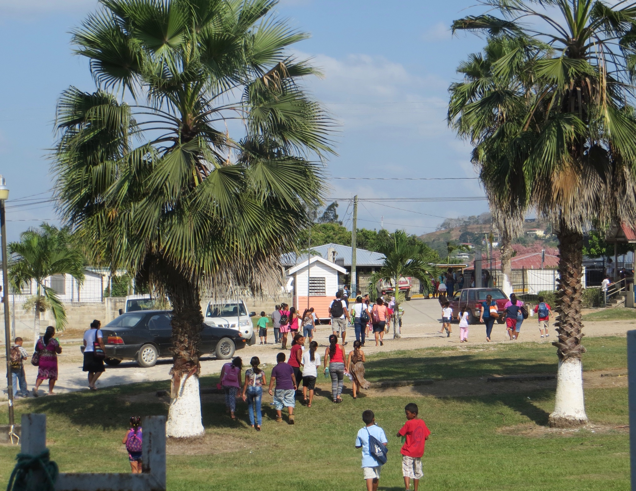
Notes:
Students arriving at Sacred Heart College. Note how many people are walking and how few vehicles there are. Students were walking up to 5 miles (8km) one way in 50 degree heat to get to the camp (on their Easter vacation!).

Slide 5
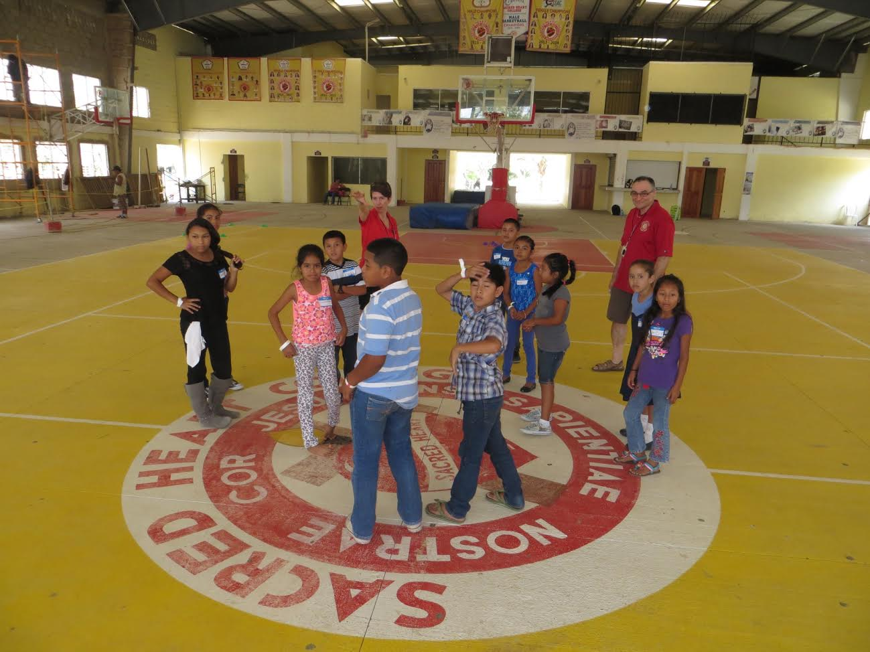
The Camp
Over 300 students
About 60 Belizean teachers
3 Days of Literacy Camp
2 Days of Professional Development
Sacred Heart College is one of the nicest schools in the country
Most students had never seen a real gym before
Notes:
Louvred windows, open doorways, open ends, brushed concrete floor. The national basketball team was scheduled to practice before we arrived on two of the days we were there.

Slide 6
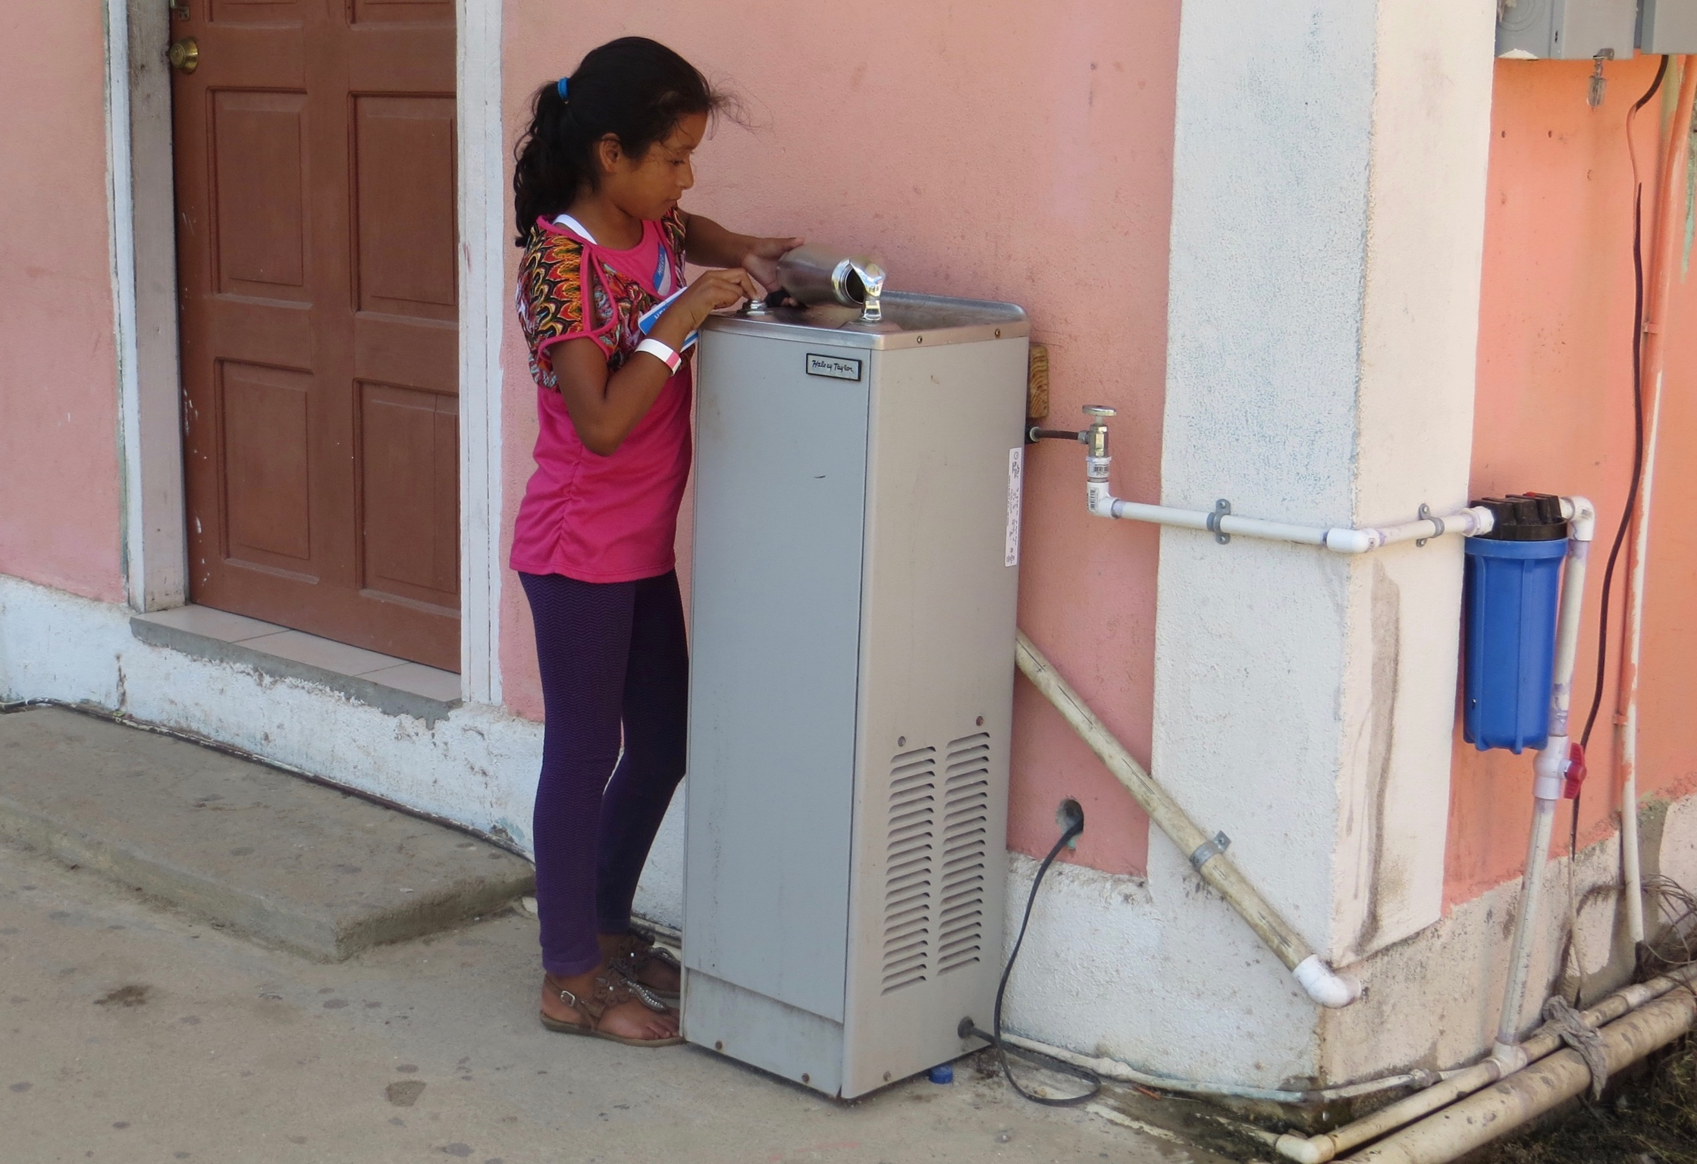
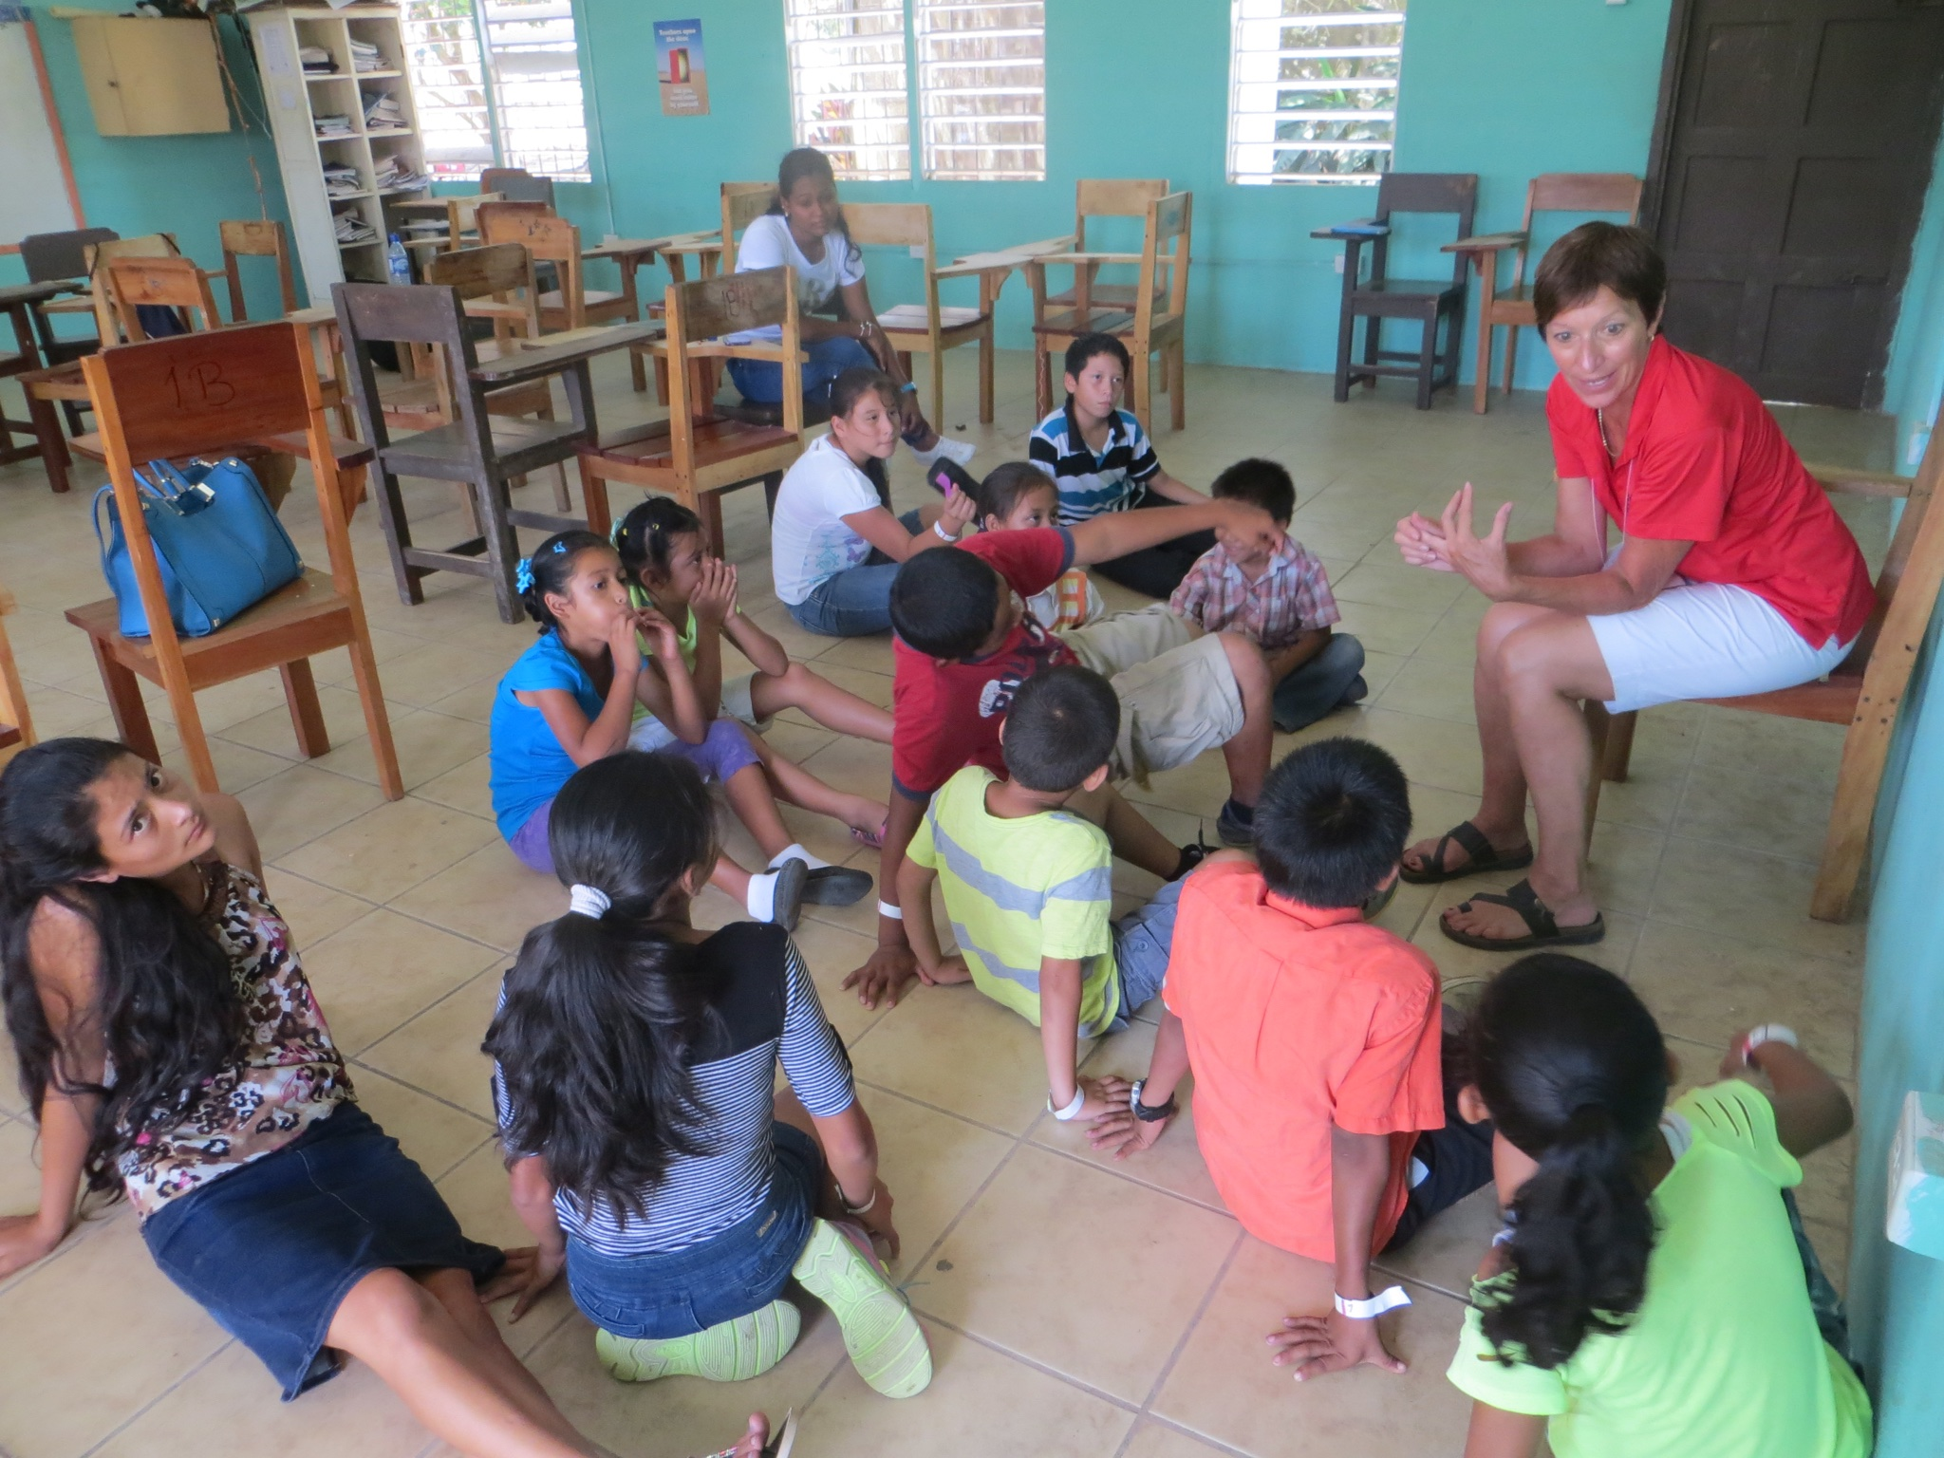
The Classrooms
Typical classroom.
Most students had never seen a water fountain before, which made for a bit of a funny story
Notes:
Students were trying to suck the water through the spout like a straw because they didn’t know you had to push the button to make the water come out.

Slide 7
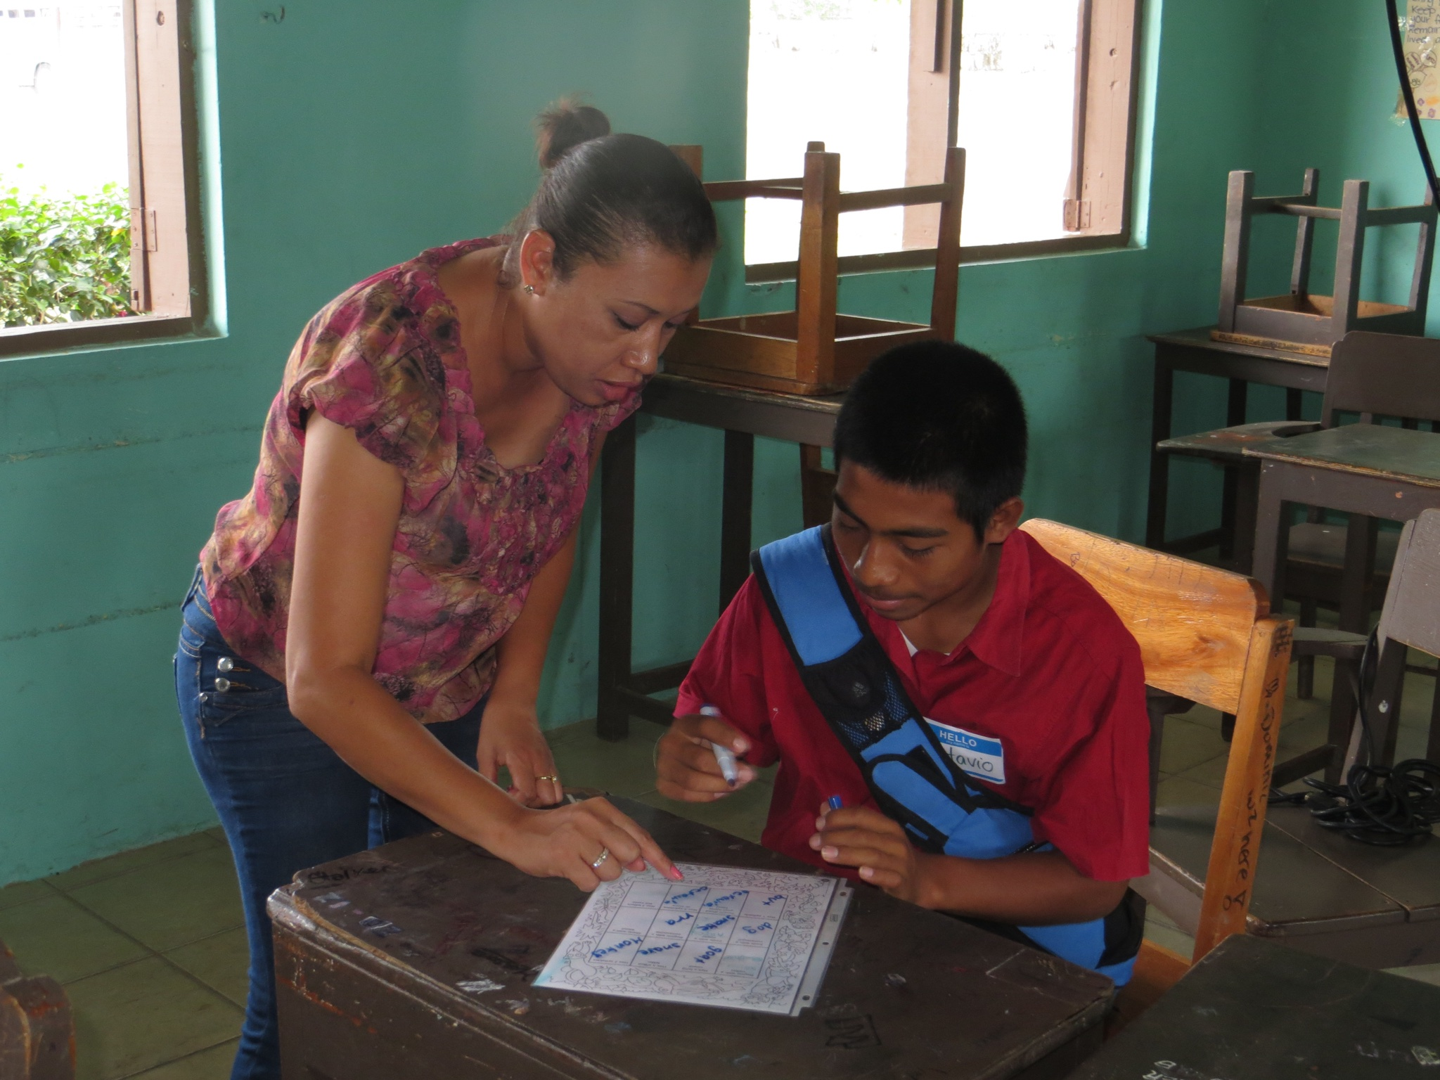
Library
ONE library for the entire school district!
Schools can place an order a week in advance to have books delivered
Schools typically make an order once a month
Sometimes classes take field trips to see the library
Notes:
How lucky are we???

Slide 8
We Made National News!
Our camp was featured on Belize’s national news channel, LOVE television
http://www.lovetv.com.bz/love-television-evening-news-for-tuesday-march-31-2016/
Notes:
48:50
In the news clip, a Belizean teacher spoke on the value of the camp for himself, the students and other professionals

Slide 9
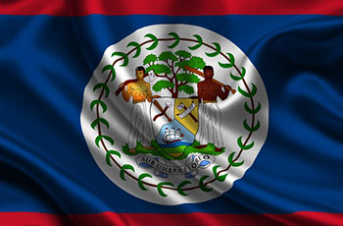
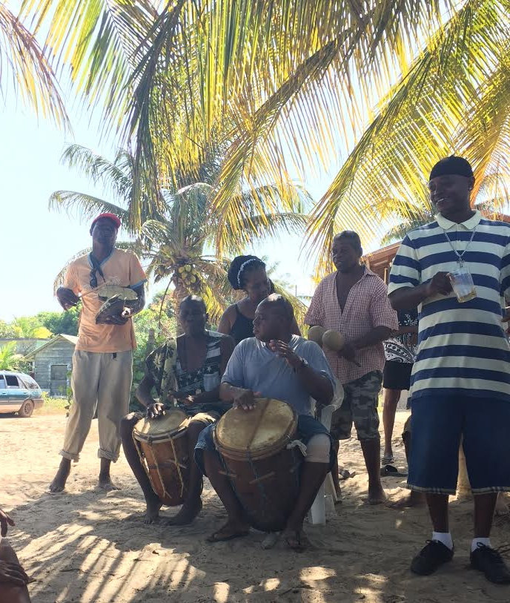
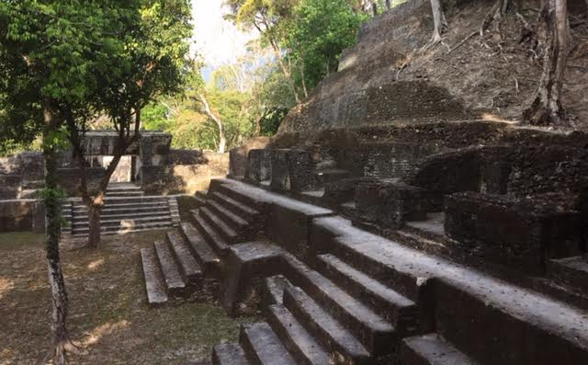
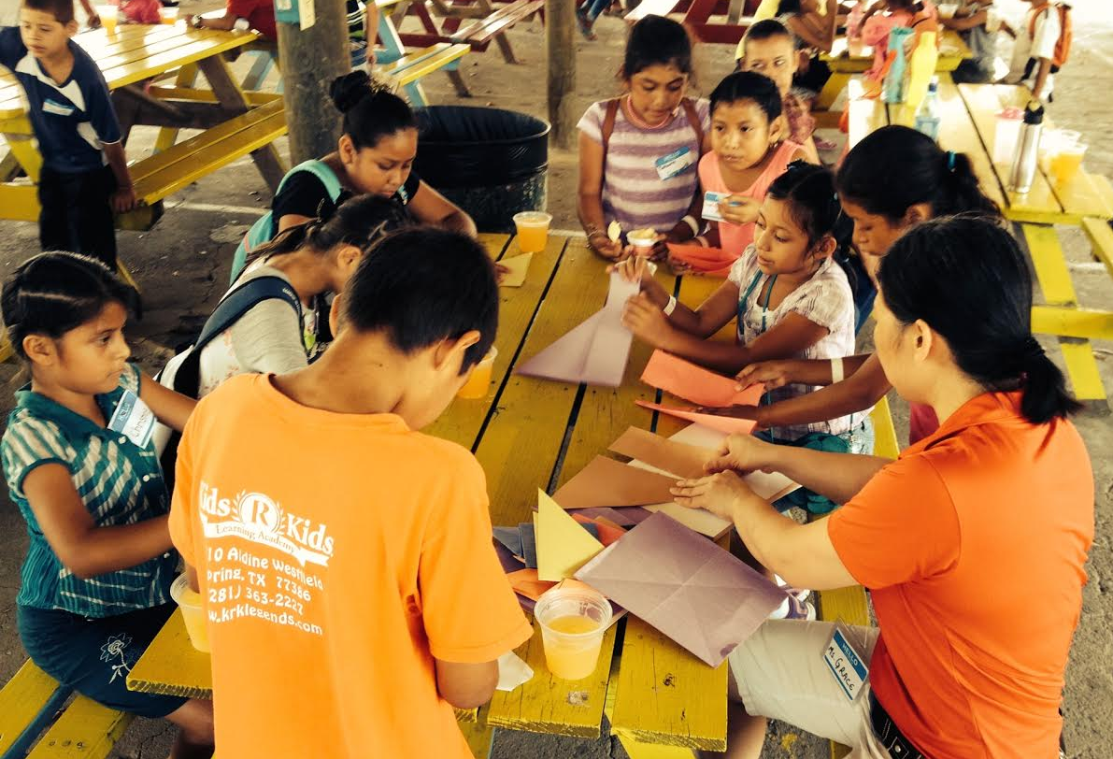
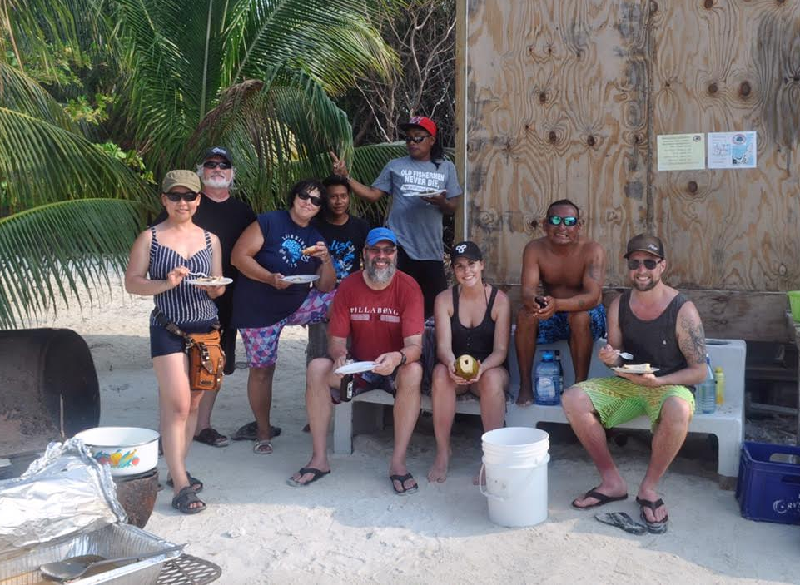
Voluntravel
Notes:
Great way to see the country without the “tourist filter”
-diving the blue hole, caving, fishing, etc.

Slide 10
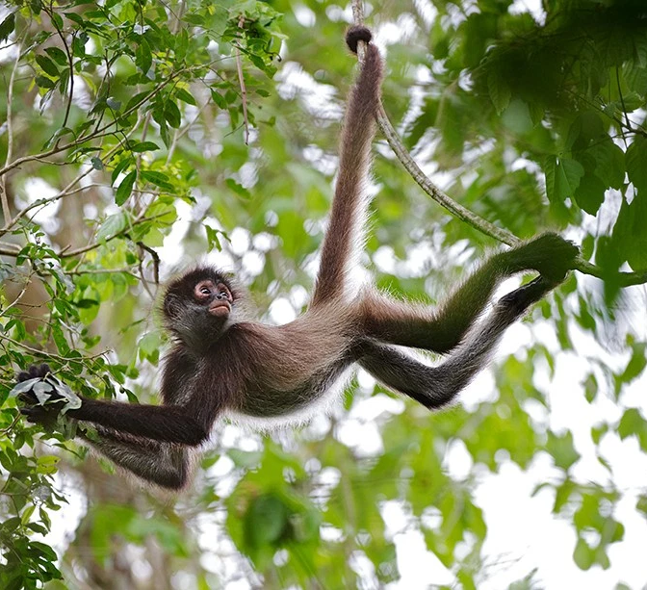
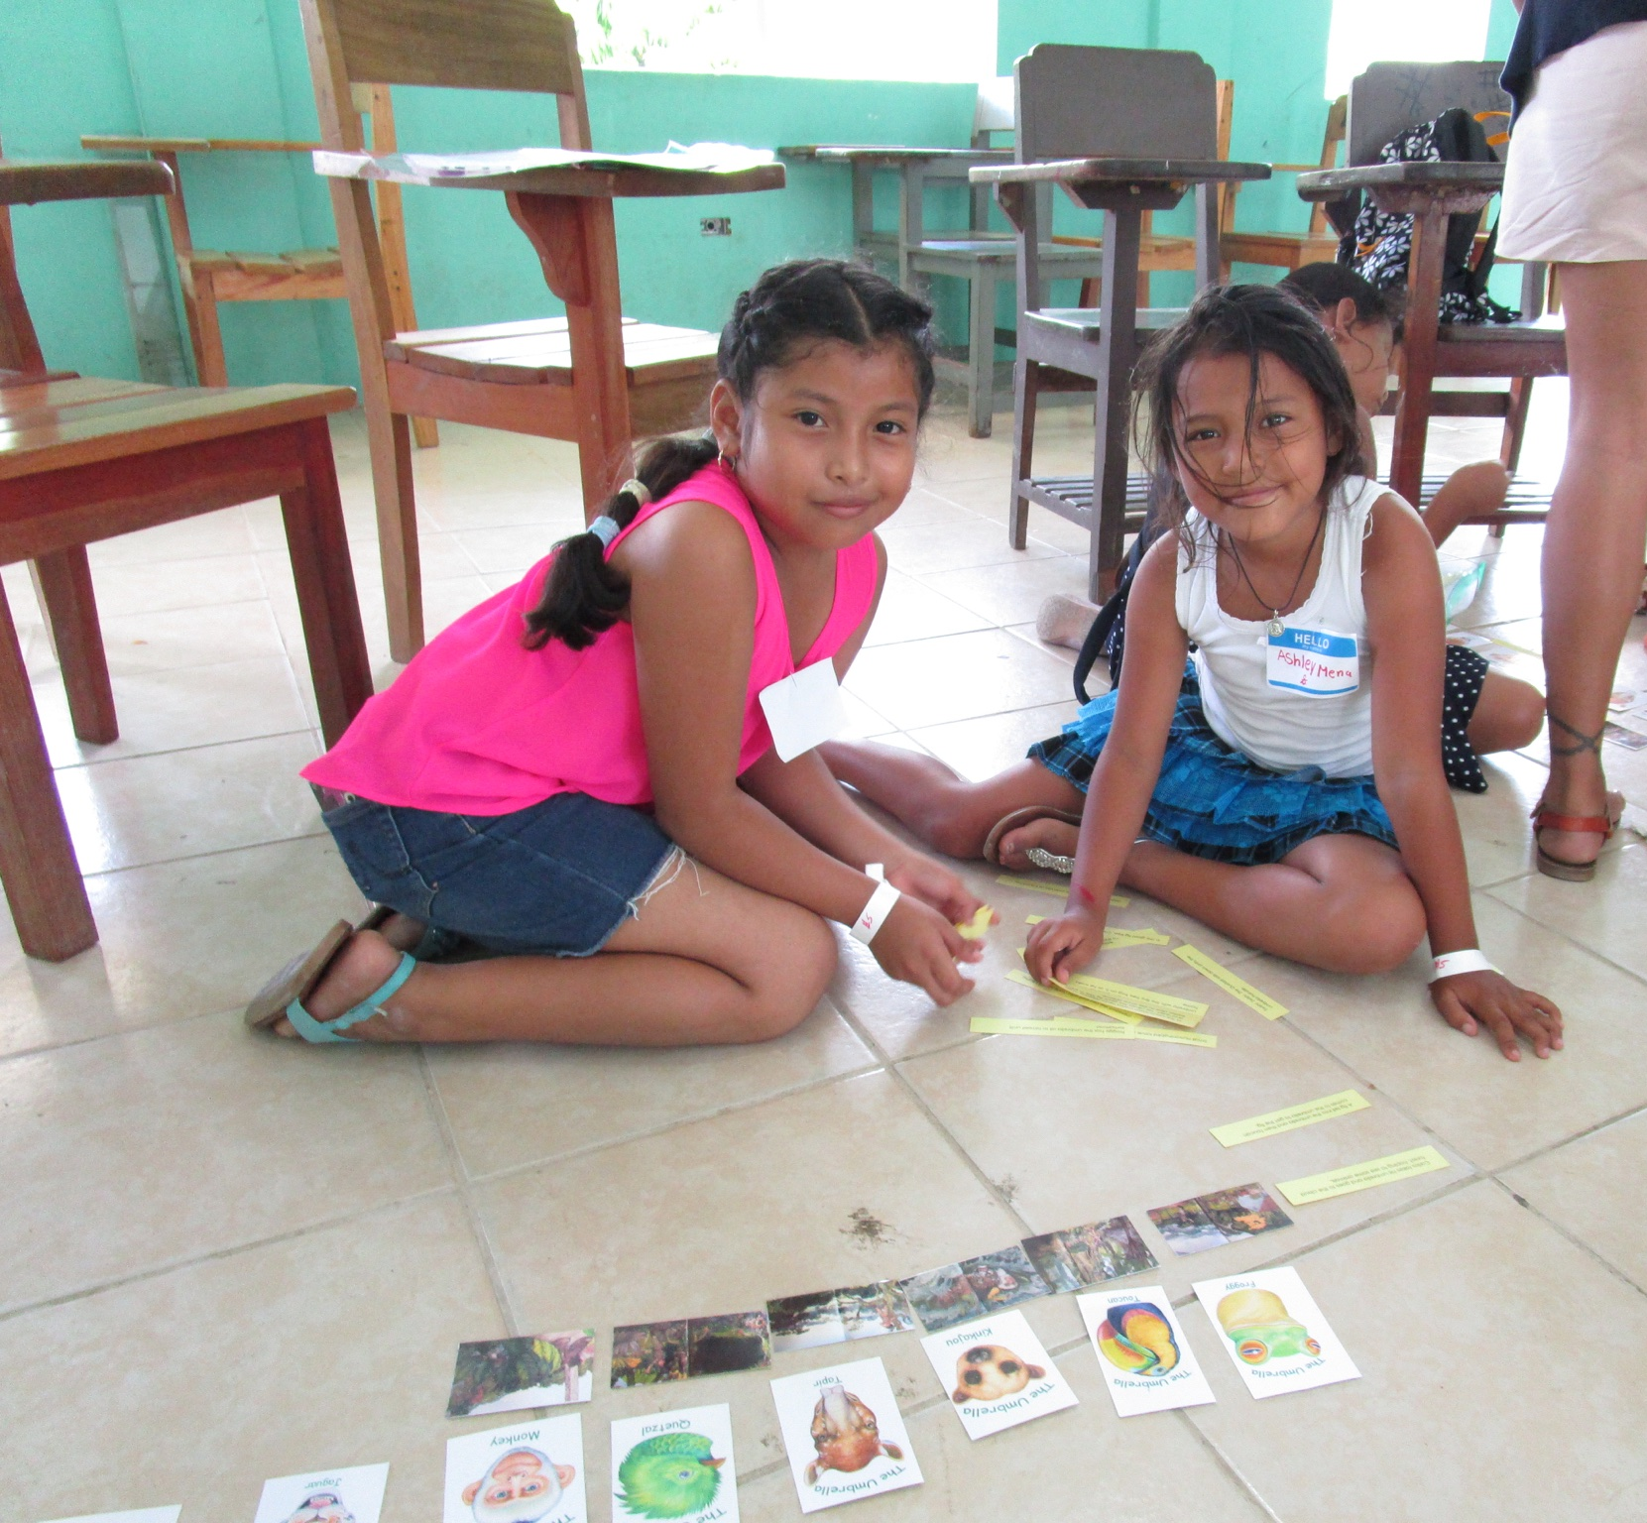
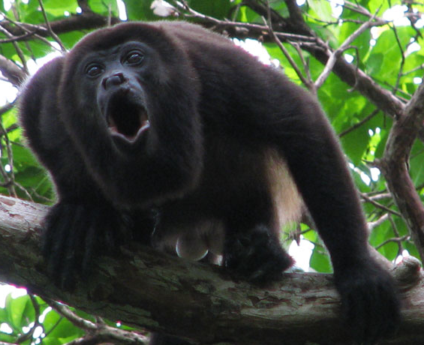
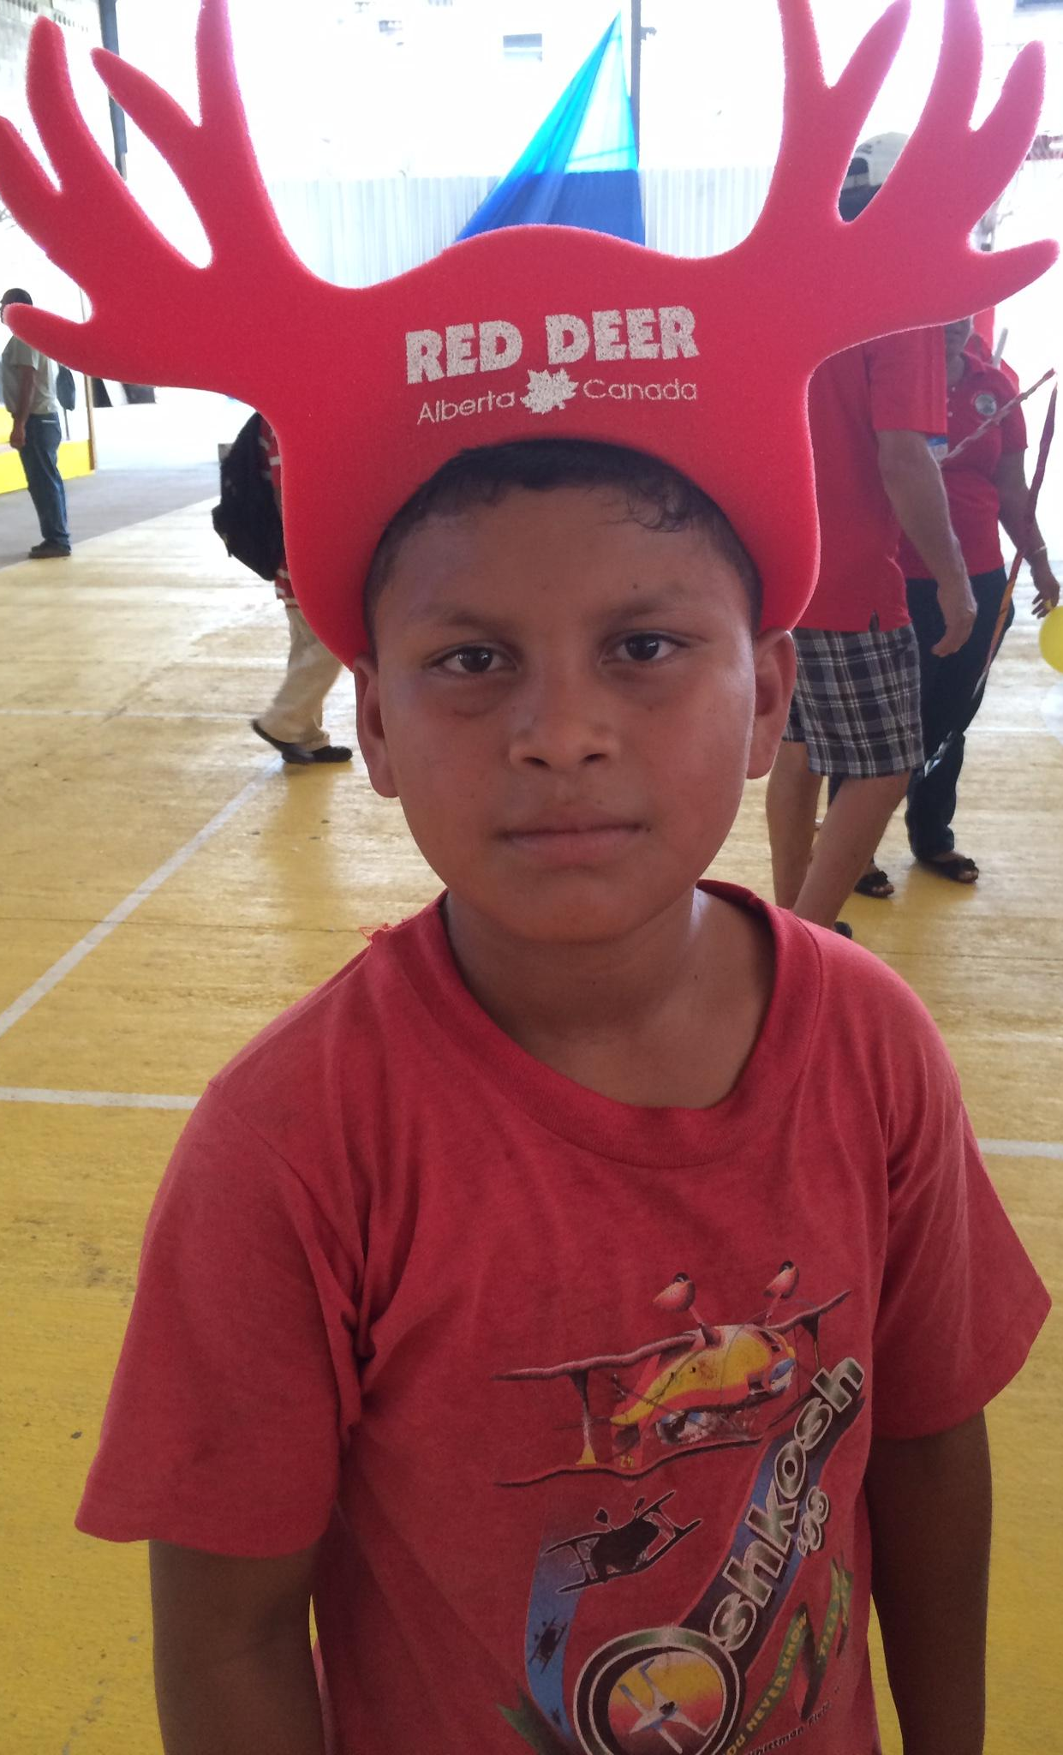
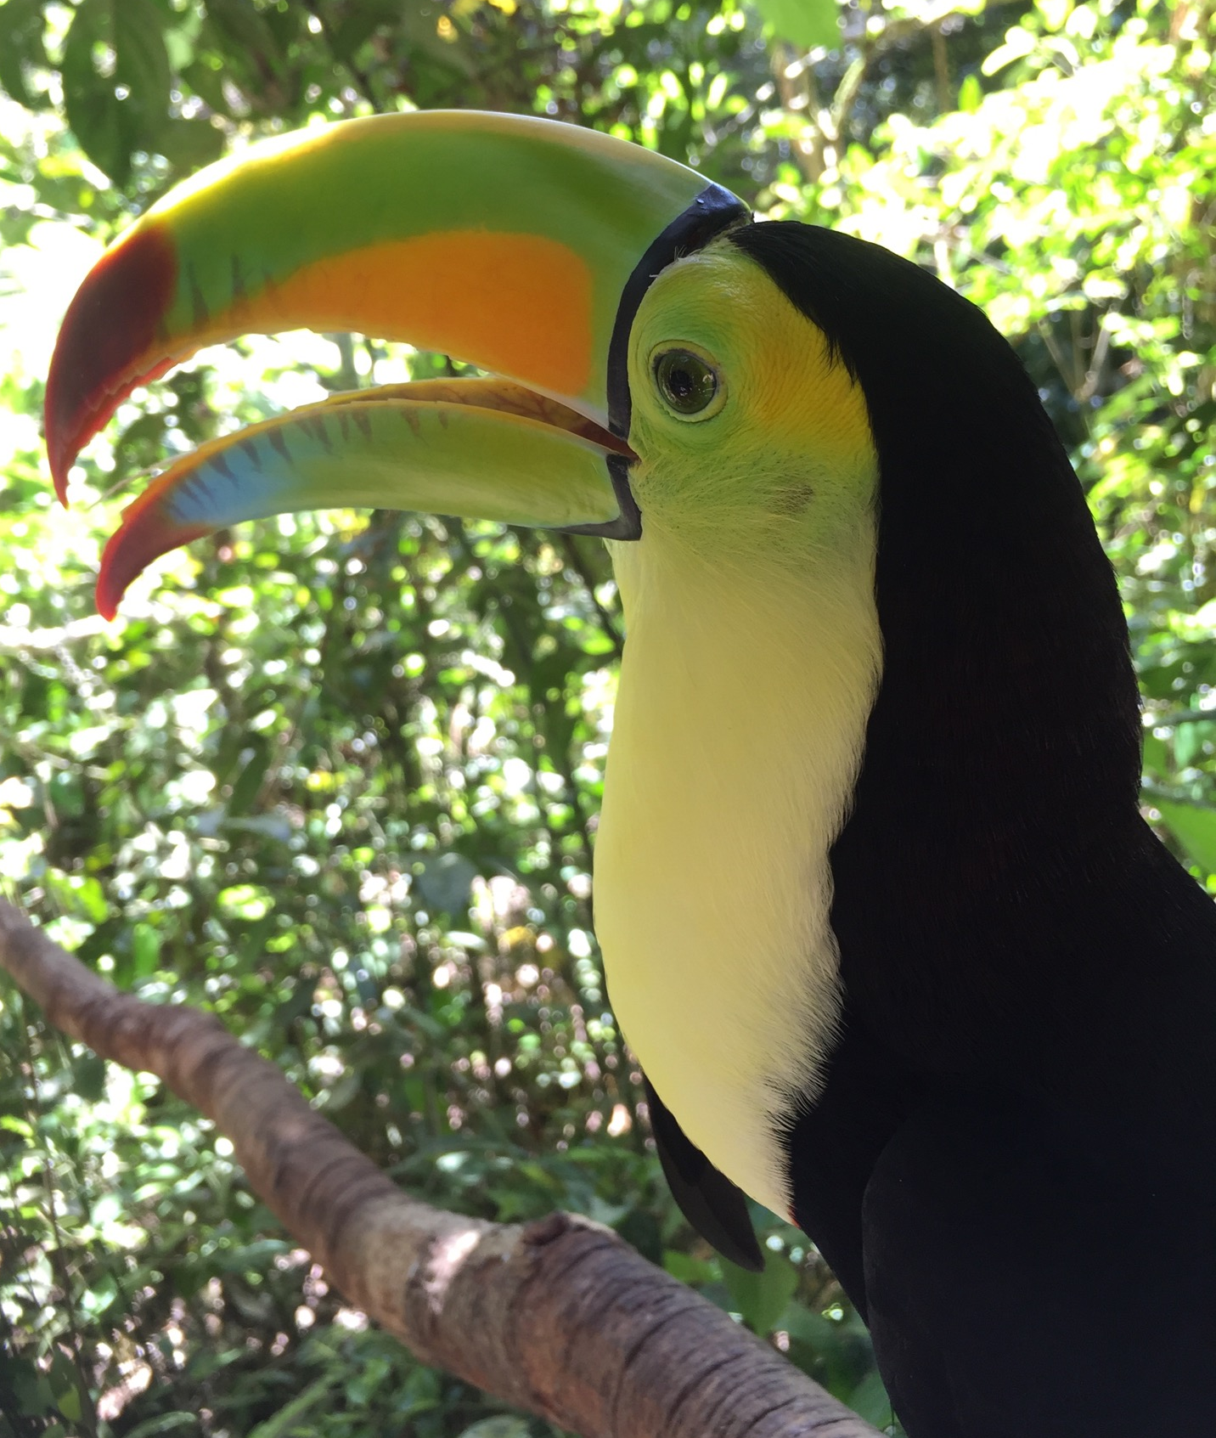

Slide 11
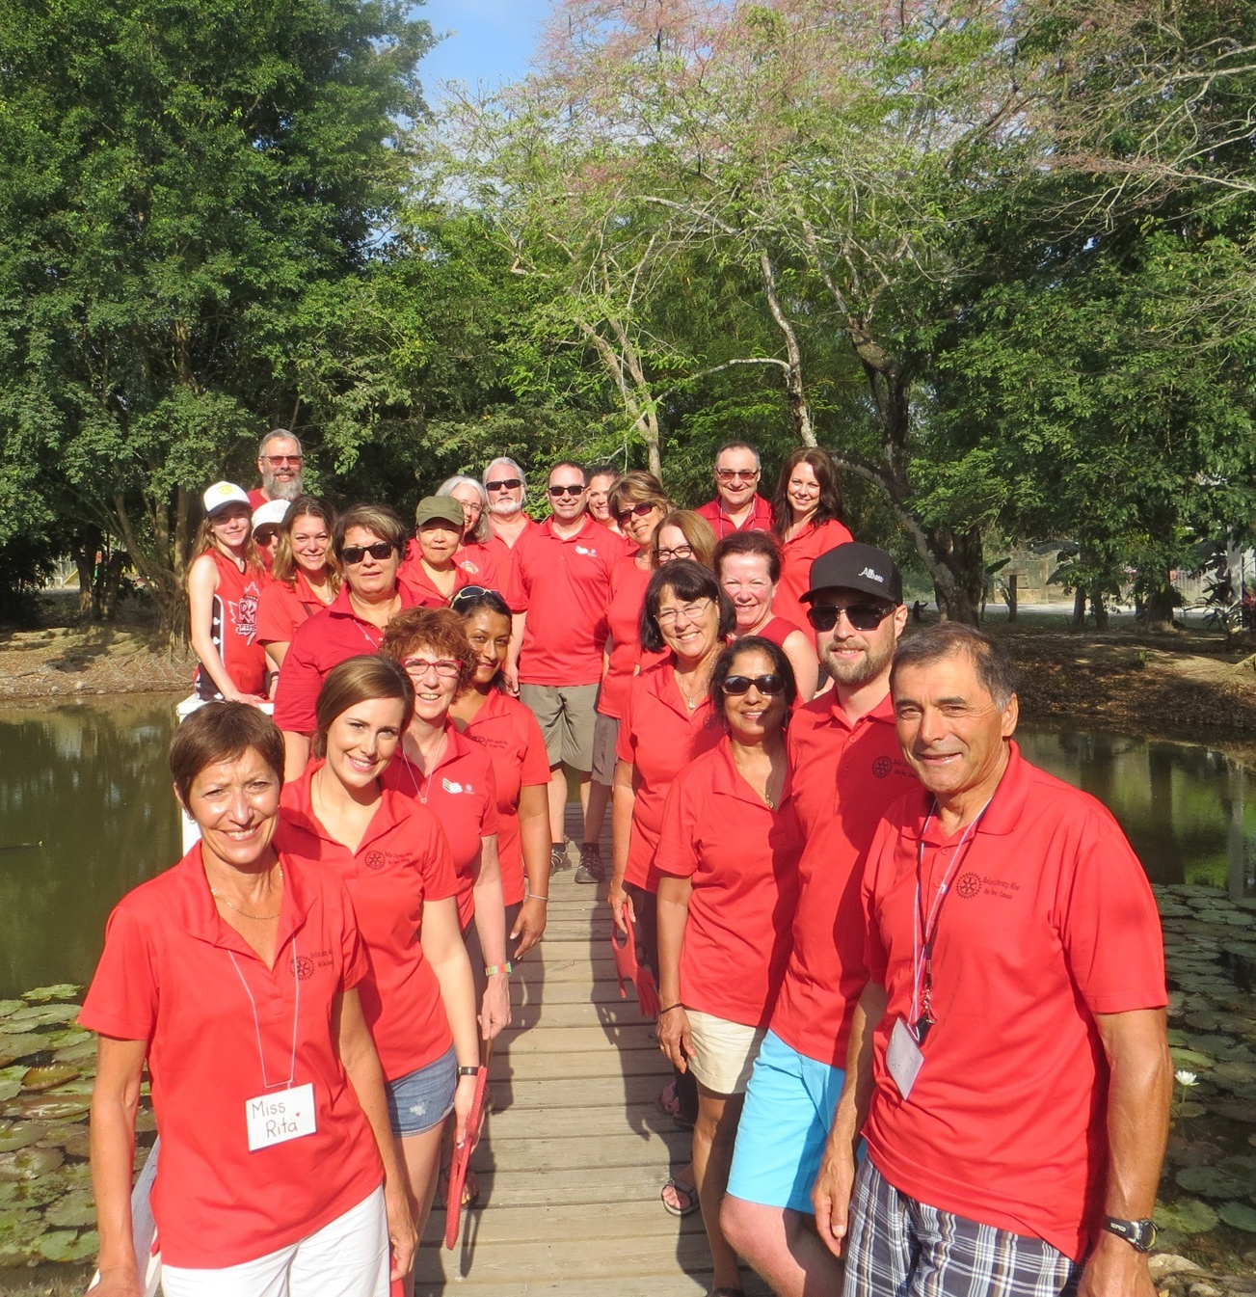
Well That’s Great...but what’s in it for us?
Life changing experience
Appreciation
Networking
Skill development
Leadership
Collaboration
Program development/implementation
Problem solving/adapting
Creation of Empowered Leaders
Making a difference is not just a cliche
Notes:
Problem solving/adapting/thinking on your feet
-one day something may not go as planned, revise and try again
-working with Belizean teachers
-unexpected age/skill variance

Slide 12
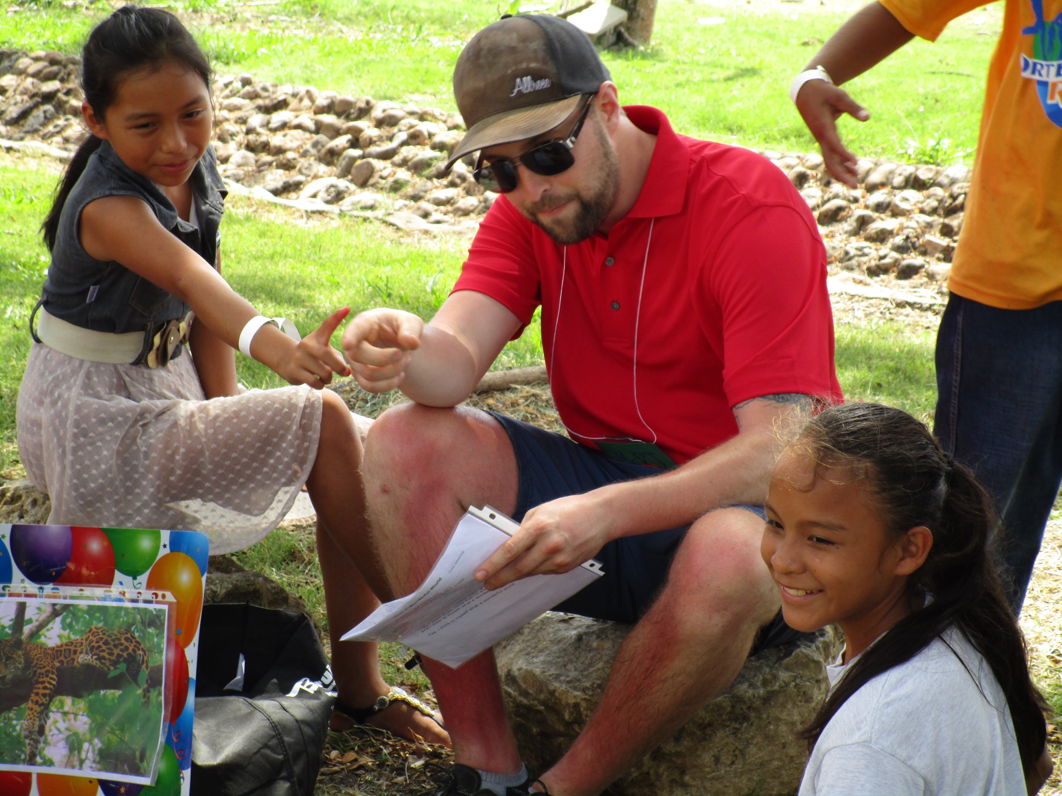
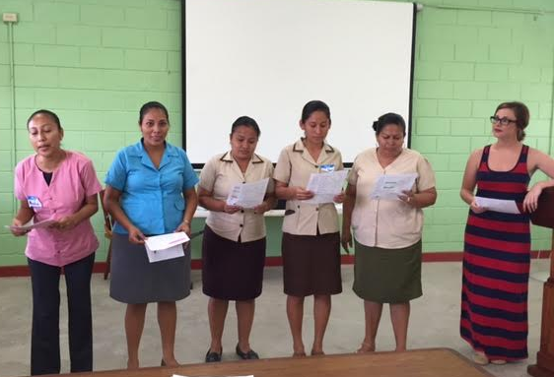
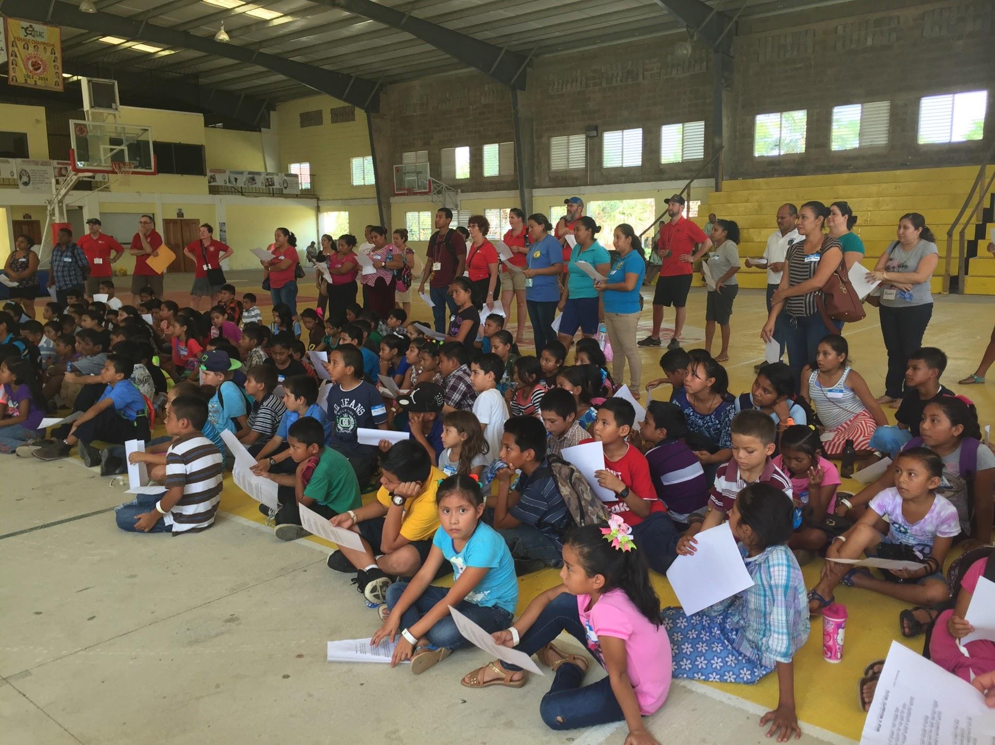
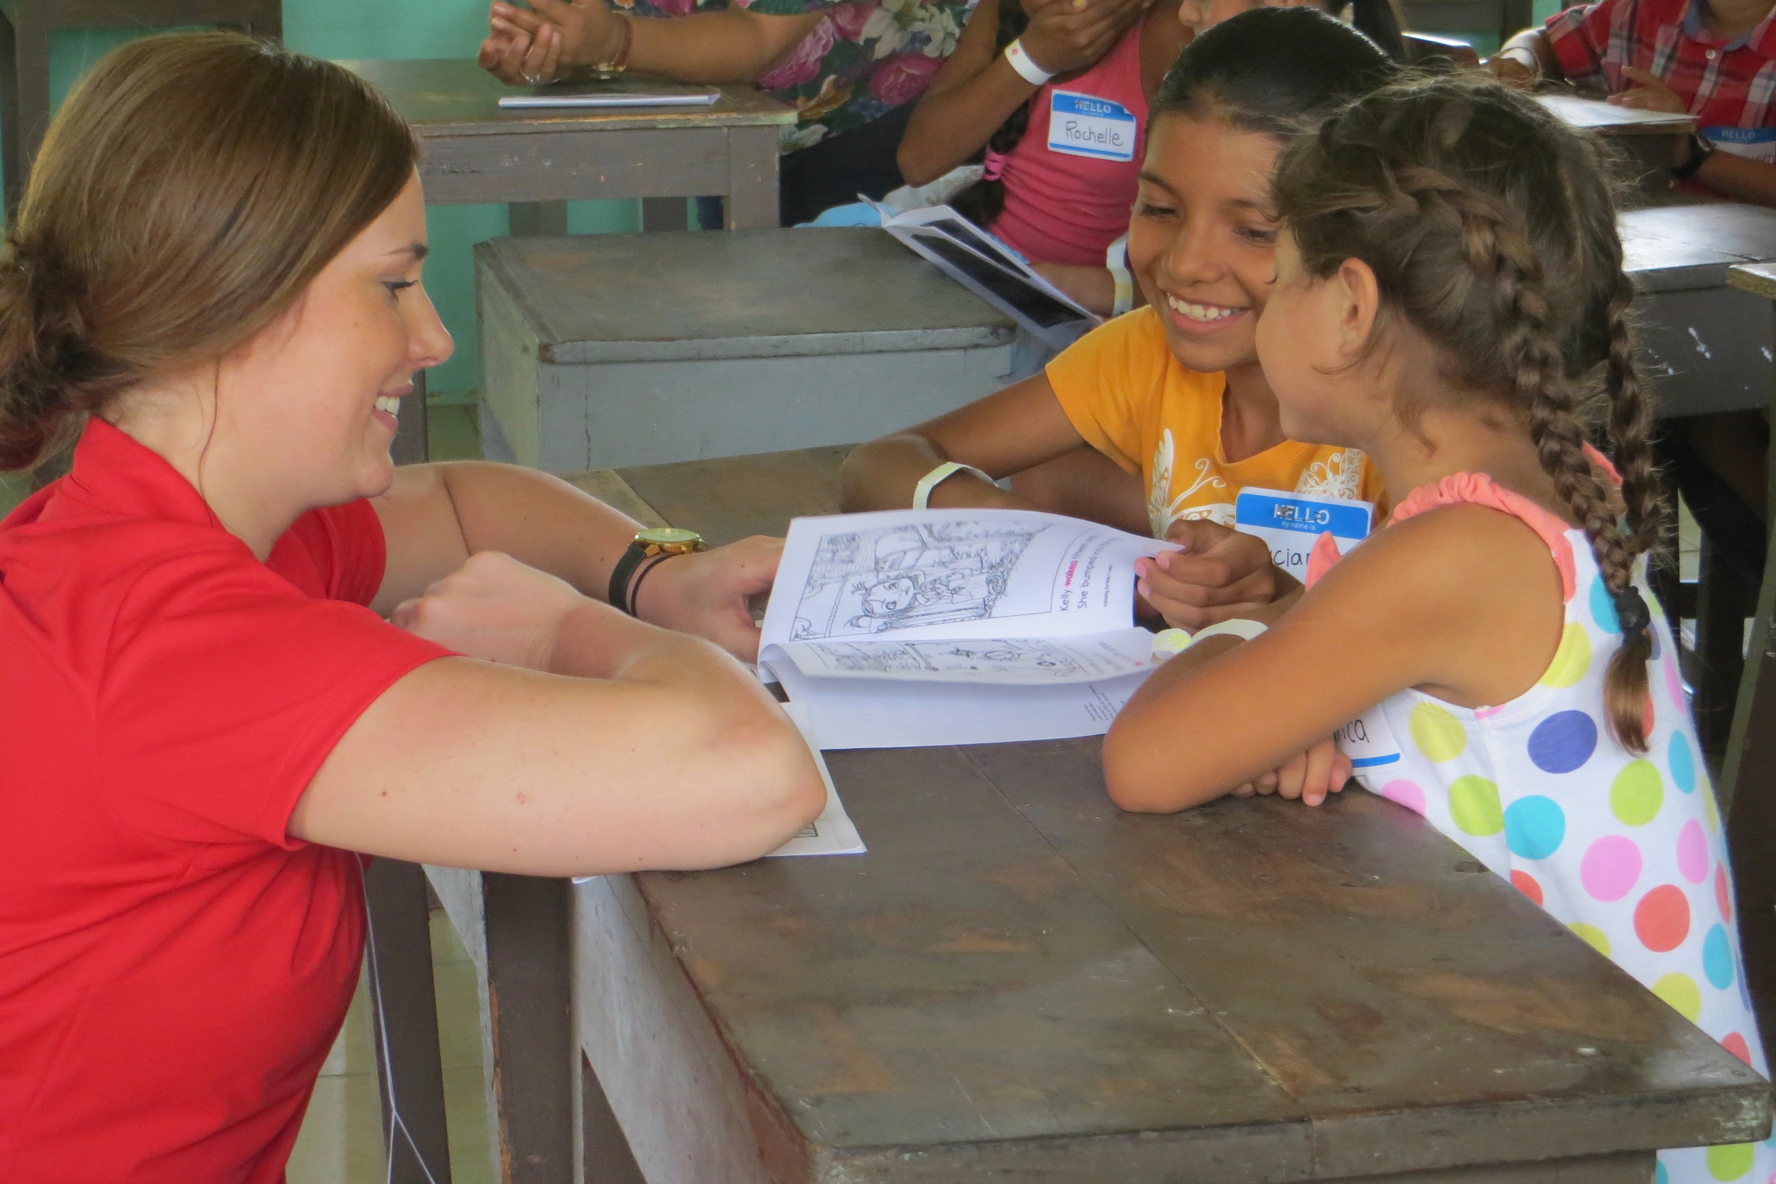
Thank You
For
Your Time!
Notes:
Is it the TRUTH? (SIB proves there is a need for improvement in literacy rates)
Is it FAIR to all concerned? (No hidden agenda, no obligations, just education)
Will it build GOODWILL and BETTER FRIENDSHIPS? (Facebook post about Fort. McMurray Wildfires on San Ignacio Rotary Page)
Will it be BENEFICIAL to all concerned? See presentation...
Based on our experience, and for what it’s worth, there is both a need and an interest in this initiative. The numbers grew every day just through word of mouth. We met some students as old as 15 who could not read. Door prizes at the dinner; everything went (resources, class supplies, etc.)

